Slide 1
Data Mining-Association Rules and Clustering
CS157A
Prof. Sin-Min Lee

Slide 2
What can be inferred?
I purchase diapers
I purchase a new car
I purchase OTC cough medicine
I purchase a prescription medication
I don’t show up for class

Slide 3
The Introduction to Data Mining
The process of extracting valid, previously unknown, comprehensible, and actionable information from large databases and using it to make crucial business decisions.

Slide 4


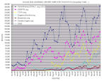
OVERVIEW
1. What is predictive modeling
2. Two phases of predictive modeling
1)Training phase
2)Testing phase
3. Two techniques of predictive modeling
    1)Classification
      Tree induction
      Neural network
    2)Value Prediction
      Linear regression
      Nonlinear regression
Notes:
OK, now, let me talk about predictive modeling, which is one of four techniques of data mining. I will cover three areas, which are the introduction of predictive modeling, two phases of predictive modeling, and two techniques of predictive modeling. As for the techniques of the predictive modeling, we are also going to discuss classification and value prediction.

Slide 5
1. Predictive modeling
Similar to human learning experience
Use observations !
Form a model of important characteristics of some phenomenon
Notes:
So, what’s the predictive modeling? It’s simple, we have predictors, and we are trying to make prediction value. It’s very similar to human learning experience. We use observations to form a model of the important characteristics of some phenomenon.

Slide 6
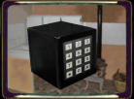


1. Predictive modeling (contd.)
A “black box” that makes predictions about the future based on information from the past and present
Application: customer retention management, credit approval, direct marketing.
Notes:
It’s pretty much like a “black box” that makes predictions about the future based on information from the past and present. And large number of inputs usually is available. And the predictive modeling is widely used in customer retention management, credit approval, and direct marketing areas

Slide 7
1. Predictive modeling (contd.)
Age
Model
Will customer file bankruptcy (Yes/No)
Blood Pressure
Eye color
Notes:
So, if we have a predictive model. And there are three predictors in this model, which are age, blood pressure, and eye color. And we try to figure out if the customers file bankruptcy. And that’s the basic idea how a predictive model works.

Slide 8
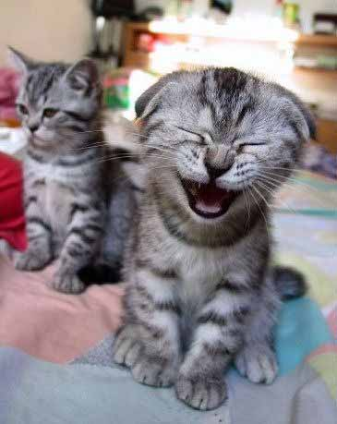
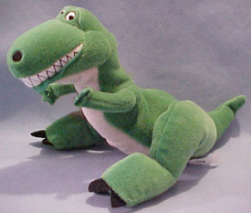
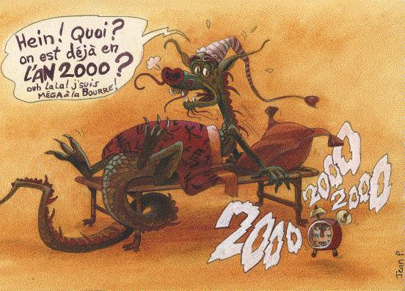
Definitions
Maps data item into one of several clusters, where clusters are natural groupings of data items based on similarity metrics or probability density models.
Multi-scale representation of data refers to visualization of the data at different ‘scales’, where the term scale may signify either unit, frequency, radius, window size or kernel parameters.

Slide 9
Definitions
The nontrivial process of identifying valid, novel, potentially useful, and ultimately understandable patterns in data
Drawing circles and shapes around dots representing objects!

Slide 10

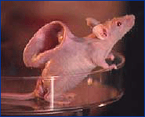

Overview of Clustering
Cluster analysis has wide application including market/customer segmentation, pattern recognition, biological studies, and Web document classification
Clustering is a dynamic field of research in data mining. The algorithms can be categorized into partitioning, hierarchical, density-based, and model-based methods

Slide 11
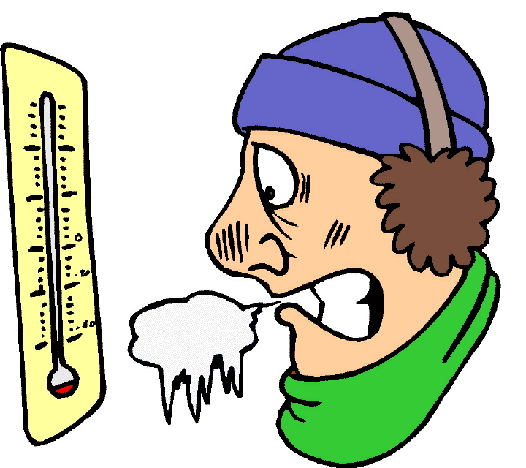

Data Types in Cluster Analysis
Interval-Scaled Variables
  Continuous measurements of a roughly linear scale
  Weight, height, latitude, temperature
  How to compute their differences?

Slide 12
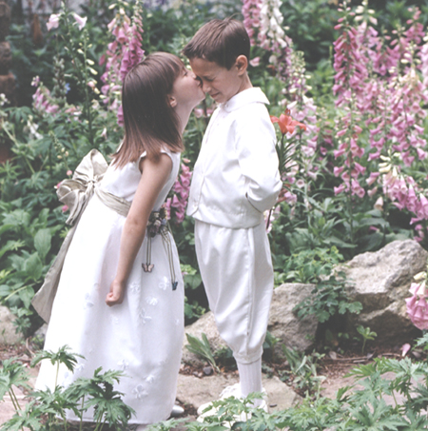
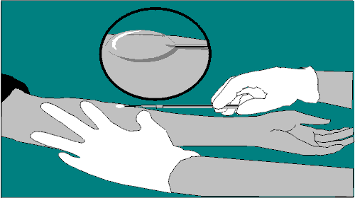
Data Types in Cluster Analysis
Binary Variables
  Only two states: 0 or 1
  However, it can be symmetric/asymmetric
    Symmetric – gender
    Asymmetric – outcome of a disease test

Slide 13
Data Types in Cluster Analysis
Nominal Variables
  A generalization of the binary variable in that it can take on more than two states.
  For example, a color be white, green, blue, red.
  How is dissimilarity computed?
    Matching approach d(i,j)=(p-m)/p
    M is the number of similar attributes between I and j
    P is the number of total attributes between I and j

Slide 14

Data Types in Cluster Analysis
Ratio-Scaled Variables
  A positive measurement on a nonlinear scale, such as an exponential scale
  Growth of bacteria population
  Decay of radioactive element
  How to compute dissimilarity?
    Just like Interval-based variables
    But needs a transformation:
      Apply logarithmic transformation to a linearly ratio-scaled variable
      Some times we may need to use log-log, log-log-log, and so on... Very exciting!

Slide 15
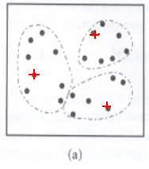
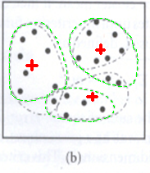
K-Mean Method
K-mean algorithm creates clusters by determining a central mean for each cluster
The algorithm starts by randomly select K entities as the means of K clusters and randomly adds entities to each clusters
Then, it re-computes cluster mean and re-assigns entities to clusters to which it is most similar, based on the distance between entity and the cluster mean.

Slide 16
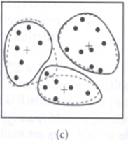
K-Mean Method
Then, the mean is recomputed at each cluster, and previous entities either stay / move to a different cluster, and one iteration completes
Algorithm iterates until there is no change of the means at each clusters.

Slide 17
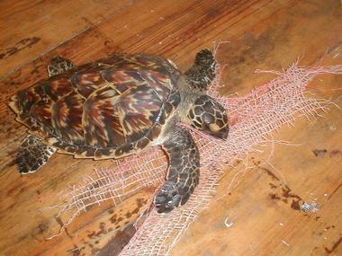
K-Mean Method
K-mean is fast!
  Computation complexity is O(K*n*t)
  K is the number of clusters
  N is the total number of objects
  T is the number of iterations
But K-mean are sensitive to outliers!
  Outliers at the edge of the cluster may cause the cluster creates a skewed mean.

Slide 18
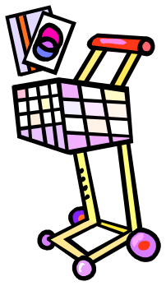
Market Basket Analysis
Retail – each customer purchases different set of products, different quantities, different times
MBA uses this information to:
  Identify who customers are (not by name)
  Understand why they make certain purchases
  Gain insight about its merchandise (products):
    Fast and slow movers
    Products which are purchased together
    Products which might benefit from promotion
  Take action:
    Store layouts
    Which products to put on specials, promote, coupons…
Combining all of this with a customer loyalty card it becomes even more valuable

Slide 19
Transactional Data
Market basket example:
  Basket1: {bread, cheese, milk}
  Basket2: {apple, eggs, salt, yogurt}
  …
  Basketn: {biscuit, eggs, milk}
Definitions:
  An item: an article in a basket, or an attribute-value pair
  A transaction: items purchased in a basket; it may have TID (transaction ID)
  A transactional dataset: A set of transactions

Slide 20
Itemsets and Association Rules
An itemset is a set of items.
  E.g., {milk, bread, cereal} is an itemset.
A k-itemset is an itemset with k items.
Given a dataset D, an itemset X has a (frequency) count in D
An association rule is about relationships between two disjoint itemsets X and Y
X ⇒ Y
It presents the pattern when X occurs, Y also occurs

Slide 21
Use of Association Rules
Association rules do not represent any sort of causality or correlation between the two itemsets.
  X ⇒ Y does not mean X causes Y, so no Causality
  X ⇒ Y can be different from Y ⇒ X, unlike correlation
Association rules assist in marketing, targeted advertising, floor planning, inventory control, churning management, homeland security, …
Notes:
A 100-year old furniture giant (W…) claimed bankruptcy, who started the brochure shopping in the US.

Slide 22

Association Rules
DM technique most closely allied with Market Basket Analysis
AR can be automatically generated
  AR represent patterns in the data without a specified target variable
  Good example of undirected data mining
  Whether patterns make sense is up to humanoids (us!)

Slide 23
Association Rules Apply Elsewhere
Besides retail – supermarkets, etc…
Purchases made using credit/debit cards
Optional Telco Service purchases
Banking services
Unusual combinations of insurance claims can be a warning of fraud
Medical patient histories

Slide 24

Market Basket Analysis Drill-Down
MBA is a set of techniques, Association Rules being most common, that focus on point-of-sale (p-o-s) transaction data
3 types of market basket data (p-o-s data)
  Customers
  Orders (basic purchase data)
  Items (merchandise/services purchased)

Slide 25
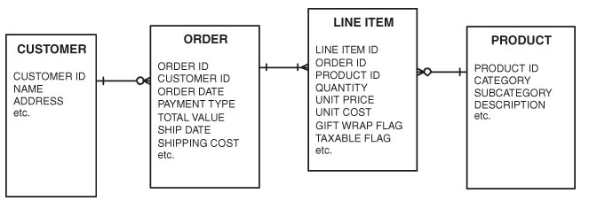
Typical Data Structure (Relational Database)
Lots of questions can be answered
  Avg # of orders/customer
  Avg # unique items/order
  Avg # of items/order
  For a product
    What % of customers have purchased
    Avg # orders/customer include it
    Avg quantity of it purchased/order
  Etc…
Visualization is extremely helpful…next slide
Transaction Data

Slide 26
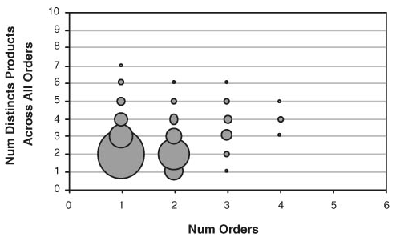
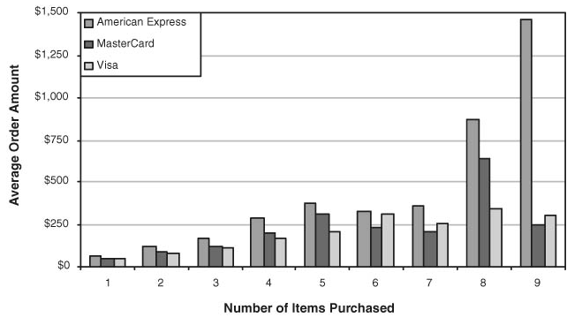
Sales Order Characteristics

Slide 27
Sales Order Characteristics
Did the order use gift wrap?
Billing address same as Shipping address?
Did purchaser accept/decline a cross-sell?
What is the most common item found on a one-item order?
What is the most common item found on a multi-item order?
What is the most common item for repeat customer purchases?
How has ordering of an item changed over time?
How does the ordering of an item vary geographically?
Yada…yada…yada…

Slide 28
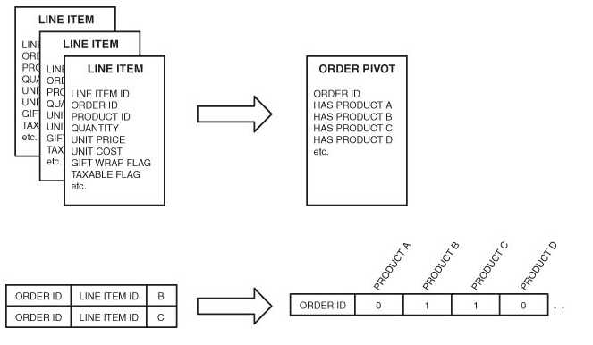
Pivoting for Cluster Algorithms

Slide 29
Association Rules
Wal-Mart customers who purchase Barbie dolls have a 60% likelihood of also purchasing one of three types of candy bars [Forbes, Sept 8, 1997]
Customers who purchase maintenance agreements are very likely to purchase large appliances (author experience)
When a new hardware store opens, one of the most commonly sold items is toilet bowl cleaners (author experience)
So what…

Slide 30

Association Rules
Association rule types:
  Actionable Rules – contain high-quality, actionable information
  Trivial Rules – information already well-known by those familiar with the business
  Inexplicable Rules – no explanation and do not suggest action
Trivial and Inexplicable Rules occur most often

Slide 31
How Good is an Association Rule?
Customer | Items Purchased
1 | OJ, soda
2 | Milk, OJ, window cleaner
3 | OJ, detergent
4 | OJ, detergent, soda
5 | Window cleaner, soda
POS Transactions
Co-occurrence of
Products
 | OJ | Window cleaner | Milk | Soda | Detergent
OJ | 4 | 1 | 1 | 2 | 2
Window cleaner | 1 | 2 | 1 | 1 | 0
Milk | 1 | 1 | 1 | 0 | 0
Soda | 2 | 1 | 0 | 3 | 1
Detergent | 2 | 0 | 0 | 1 | 2

Slide 32
How Good is an Association Rule?
 | OJ | Window cleaner | Milk | Soda | Detergent
OJ | 4 | 1 | 1 | 2 | 2
Window cleaner | 1 | 2 | 1 | 1 | 0
Milk | 1 | 1 | 1 | 0 | 0
Soda | 2 | 1 | 0 | 3 | 1
Detergent | 2 | 0 | 0 | 1 | 2
Simple patterns:
1. OJ and soda are more likely purchased together than
any other two items
2. Detergent is never purchased with milk or window cleaner
3. Milk is never purchased with soda or detergent

Slide 33
How Good is an Association Rule?
POS Transactions
Customer | Items Purchased
1 | OJ, soda
2 | Milk, OJ, window cleaner
3 | OJ, detergent
4 | OJ, detergent, soda
5 | Window cleaner, soda
What is the confidence for this rule:
  If a customer purchases soda, then customer also purchases OJ
  2 out of 3 soda purchases also include OJ, so 67%
What about the confidence of this rule reversed?
  2 out of 4 OJ purchases also include soda, so 50%
Confidence = Ratio of the number of transactions with all the items to the number of transactions with just the “if” items

Slide 34
How Good is an Association Rule?
How much better than chance is a rule?
Lift (improvement) tells us how much better a rule is at predicting the result than just assuming the result in the first place
Lift is the ratio of the records that support the entire rule to the number that would be expected, assuming there was no relationship between the products
Calculating lift…p 310…When lift > 1 then the rule is better at predicting the result than guessing
When lift < 1, the rule is doing worse than informed guessing and using the Negative Rule produces a better rule than guessing
Co-occurrence can occur in 3, 4, or more dimensions…

Slide 35
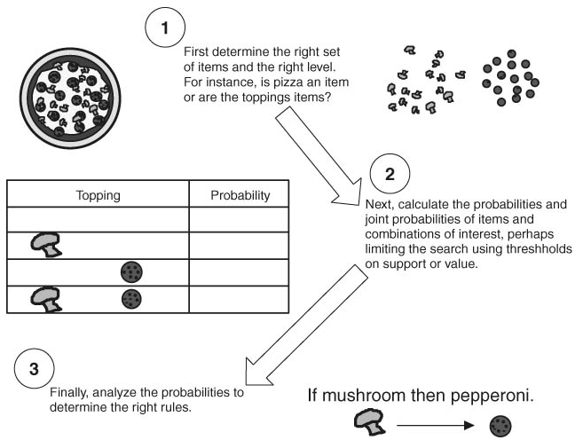
Creating Association Rules
Choosing the right set of items
Generating rules by deciphering the counts in the co-occurrence matrix
Overcoming the practical limits imposed by thousands or tens of thousands of unique items

Slide 36
Overcoming Practical Limits for Association Rules
Generate co-occurrence matrix for single items…”if OJ then soda”
Generate co-occurrence matrix for two items…”if OJ and Milk then soda”
Generate co-occurrence matrix for three items…”if OJ and Milk and Window Cleaner” then soda
Etc…

Slide 37
Final Thought on Association Rules:
The Problem of Lots of Data
Fast Food Restaurant…could have 100 items on its menu
  How many combinations are there with 3 different menu items? 161,700 !
Supermarket…10,000 or more unique items
  50 million 2-item combinations
  100 billion 3-item combinations
Use of product hierarchies (groupings) helps address this common issue
Finally, know that the number of transactions in a given time-period could also be huge (hence expensive to analyze)

Slide 38
Support and Confidence
support of X in D is count(X)/|D|
For an association rule X⇒Y, we can calculate
  support (X⇒Y) = support (XY)
  confidence (X⇒Y) = support (XY)/support (X)
Relate Support (S) and Confidence (C) to Joint and Conditional probabilities
There could be exponentially many A-rules
Interesting association rules are (for now) those whose S and C are greater than minSup and minConf (some thresholds set by data miners)

Slide 39
How is it different from other algorithms
  Classification (supervised learning -> classifiers)
  Clustering (unsupervised learning -> clusters)
Major steps in association rule mining
  Frequent itemsets generation
  Rule derivation
Use of support and confidence in association mining
  S for frequent itemsets
  C for rule derivation

Slide 40
Example
Count, Support, Confidence:
Count(13)=2
|D| = 4
Support(13)=0.5
Support(3→2)=0.5
Confidence(3→2)=0.67
Data set D
TID | Itemsets
T100 | 1 3 4
T200 | 2 3 5
T300 | 1 2 3 5
T400 | 2 5

Slide 41
Frequent itemsets
A frequent (used to be called large) itemset is an itemset whose support (S) is ≥ minSup.
Apriori property (downward closure): any subsets of a frequent itemset are also frequent itemsets
ABC ABD ACD BCD
AB AC AD BC BD CD
A B C D

Slide 42
APRIORI
Using the downward closure, we can prune unnecessary branches for further consideration
APRIORI
  k = 1
  Find frequent set L_{k} from C_{k} of all candidate itemsets
  Form C_{k+1} from L_{k}; k = k + 1
  Repeat 2-3 until C_{k} is empty
Details about steps 2 and 3
  Step 2: scan D and count each itemset in C_{k} , if it’s greater than minSup, it is frequent
  Step 3: next slide

Slide 43
Apriori’s Candidate Generation
For k=1, C₁ = all 1-itemsets.
For k>1, generate C_{k} from L_{k-1} as follows:
  The join step
  C_{k} = k-2 way join of L_{k-1} with itself
  If both {a₁, …,a_{k-2}, a_{k-1}} & {a₁, …, a_{k-2}, a_{k}} are in L_{k-1}, then add {a₁, …,a_{k-2}, a_{k-1}, a_{k}} to C_{k}
  (We keep items sorted).
  The prune step
  Remove {a₁, …,a_{k-2}, a_{k-1}, a_{k}} if it contains a non-frequent (k-1) subset

Slide 44
Example – Finding frequent itemsets
Dataset D
1. scan D ➔ C₁: a1:2, a2:3, a3:3, a4:1, a5:3
➔ L₁: a1:2, a2:3, a3:3, a5:3
➔ C₂: a1a2, a1a3, a1a5, a2a3, a2a5, a3a5
2. scan D ➔ C₂: a1a2:1, a1a3:2, a1a5:1, a2a3:2, a2a5:3, a3a5:2
➔ L₂: a1a3:2, a2a3:2, a2a5:3, a3a5:2
  ➔ C₃: a2a3a5
  ➔ Pruned C₃: a2a3a5
3. scan D ➔ L₃: a2a3a5:2
TID | Items
T100 | a1 a3 a4
T200 | a2 a3 a5
T300 | a1 a2 a3 a5
T400 | a2 a5
minSup=0.5

Slide 45
Order of items can make difference in porcess
1. scan D ➔ C₁: 1:2, 2:3, 3:3, 4:1, 5:3
➔ L₁: 1:2, 2:3, 3:3, 5:3
➔ C₂: 12, 13, 15, 23, 25, 35
2. scan D ➔ C₂: 12:1, 13:2, 15:1, 23:2, 25:3, 35:2
Suppose the order of items is: 5,4,3,2,1
➔ L₂: 31:2, 32:2, 52:3, 53:2
  ➔ C₃: 321, 532
  ➔ Pruned C₃: 532
3. scan D ➔ L₃: 532:2
Dataset D
TID | Items
T100 | 1 3 4
T200 | 2 3 5
T300 | 1 2 3 5
T400 | 2 5
minSup=0.5
Notes:
The change of order in step 2 is to illustrate the concept of pruning.

Slide 46
Derive rules from frequent itemsets
Frequent itemsets != association rules
One more step is required to find association rules
For each frequent itemset X,
For each proper nonempty subset A of X,
  Let B = X - A
  A ⇒B is an association rule if
    Confidence (A ⇒ B) ≥ minConf,
    where support (A ⇒ B) = support (AB), and
    confidence (A ⇒ B) = support (AB) / support (A)

Slide 47
Example – deriving rules from frequent itemses
Suppose 234 is frequent, with supp=50%
  Proper nonempty subsets: 23, 24, 34, 2, 3, 4, with supp=50%, 50%, 75%, 75%, 75%, 75% respectively
  These generate these association rules:
    23 => 4, confidence=100%
    24 => 3, confidence=100%
    34 => 2, confidence=67%
    2 => 34, confidence=67%
    3 => 24, confidence=67%
    4 => 23, confidence=67%
    All rules have support = 50%

Slide 48
Deriving rules
To recap, in order to obtain A ⇒B, we need to have Support(AB) and Support(A)
This step is not as time-consuming as frequent itemsets generation
  Why?
It’s also easy to speedup using techniques such as parallel processing.
  How?
Do we really need candidate generation for deriving association rules?
  Frequent-Pattern Growth (FP-Tree)
Notes:
Han and Kamber 2001

Slide 49
Efficiency Improvement
Can we improve efficiency?
  Pruning without checking all k - 1 subsets?
  Joining and pruning without looping over entire L_{k-1}?.
Yes, one way is to use hash trees.
One hash tree is created for each pass k
  Or one hash tree for k-itemset, k = 1, 2, …

Slide 50
Hash Tree
Storing all candidate k-itemsets and their counts.
Internal node v at level m “contains” bucket pointers
  Which branch next? Use hash of m^{th} item to decide
  Leaf nodes contain lists of itemsets and counts
E.g., C₂: 12, 13, 15, 23, 25, 35; use identity hash function {} ** root
  /1 |2 \3 ** edge+label
  /2 |3 \5 /3 \5 /5
  [12:][13:] [15:] [23:] [25:] [35:] ** leaves

Slide 51
How to join using hash tree?
  Only try to join frequent k-1 itemsets with common parents in the hash tree
How to prune using hash tree?
  To determine if a k-1 itemset is frequent with hash tree can avoid going through all itemsets of L_{k-1}. (The same idea as the previous item)
Added benefit:
  No need to enumerate all k-subsets of transactions. Use traversal to limit consideration of such subsets.
  Or enumeration is replaced by tree traversal.

Slide 52
Further Improvement
Speed up searching and matching
Reduce number of transactions (a kind of instance selection)
Reduce number of passes over data on disk
Reduce number of subsets per transaction that must be considered
Reduce number of candidates

Slide 53
Speed up searching and matching
Use hash counts to filter candidates (see example)
Method: When counting candidate k-1 itemsets, get counts of “hash-groups” of k-itemsets
  Use a hash function h on k-itemsets
  For each transaction t and k-subset s of t, add 1 to count of h(s)
  Remove candidates q generated by Apriori if h(q)’s count <= minSupp
  The idea is quite useful for k=2, but often not so useful elsewhere. (For sparse data, k=2 can be the most expensive for Apriori. Why?)

Slide 54
Hash-based Example
1,3,4
2,3,5
1,2,3,5
2,5
Suppose h2 is:
  h2(x,y) = ((order of x) * 10 + (order of y)) mod 7
  E.g., h2(1,4) = 0, h2(1,5) = 1, …
  bucket0 bucket1 bucket2 bucket3 bucket4 bucket5 bucket6
14 15 23 24 25 12 13
35 34
counts 3 1 2 0 3 1 3
Then 2-itemsets hashed to buckets 1, 5 cannot be frequent (e.g. 15, 12), so remove them from C₂
Notes:
The order is 1 for 1, 2 for 2 … in this example.

Slide 55
Working on transactions
Remove transactions that do not contain any frequent k-itemsets in each scan
Remove from transactions those items that are not members of any candidate k-itemsets
  e.g., if 12, 24, 14 are the only candidate itemsets contained in 1234, then remove item 3
  if 12, 24 are the only candidate itemsets contained in transaction 1234, then remove the transaction from next round of scan.
Reducing data size leads to less reading and processing time, but extra writing time

Slide 56
Reducing Scans via Partitioning
Divide the dataset D into m portions, D1, D2,…, Dm, so that each portion can fit into memory.
Find frequent itemsets F_{i} in D_{i}, with support ≥ minSup, for each i.
  If it is frequent in D, it must be frequent in some D_{i}.
The union of all F_{i} forms a candidate set of the frequent itemsets in D; get their counts.
Often this requires only two scans of D.

Slide 57
Unique Features of Association Rules
vs. classification
  Right hand side can have any number of items
  It can find a classification like rule X ⇒ c in a different way: such a rule is not about differentiating classes, but about what (X) describes class c
vs. clustering
  It does not have to have class labels
  For X ⇒ Y, if Y is considered as a cluster, it can form different clusters sharing the same description (X).

Slide 58
Other Association Rules
Multilevel Association Rules
  Often there exist structures in data
  E.g., yahoo hierarchy, food hierarchy
  Adjusting minSup for each level
Constraint-based Association Rules
  Knowledge constraints
  Data constraints
  Dimension/level constraints
  Interestingness constraints
  Rule constraints

Slide 59
Measuring Interestingness - Discussion
What are interesting association rules
  Novel and actionable
Association mining aims to look for “valid, novel, useful (= actionable) patterns.” Support and confidence are not sufficient for measuring interestingness.
Large support & confidence thresholds ➔ only a small number of association rules, and they are likely “folklores”, or known facts.
Small support & confidence thresholds ➔ too many association rules.

Slide 60
Post-processing
Need some methods to help select the (likely) “interesting” ones from numerous rules
Independence test
  A ⇒ BC is perhaps interesting if p(BC|A) differs greatly from p(B|A) * p(C|A).
  If p(BC|A) is approximately equal to p(B|A) * p(C|A), then the information of A ⇒ BC is likely to have been captured by A ⇒ B and A ⇒C already. Not interesting.
  Often people are more familiar with simpler associations than more complex ones.

